Slide 1

The effect of technology on health

Slide 2
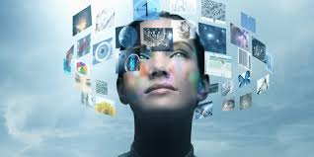
Introduction
Briefly define technology in modern life
Mention both positive and negative health impacts
Purpose: Explore how tech is shaping physical, mental, and social health

Slide 3

Positive Effects of Technology on Health
Use bullet points or icons:
Access to medical information
Telemedicine and virtual consultations
Health tracking apps and wearables
Improved diagnostics (AI, imaging)

Slide 4

Negative Effects on Physical Health
Highlight:
Eye Strain (screen Time)
Poor Posture from device use
Sedentary lifestyle to obesity
Sleep disturbance ( blue light exposure )

Slide 5
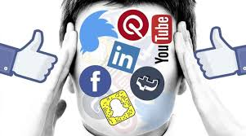
Negative Effects on Mental Health
Discuss :
Social media and anxiety/depression
Technology addiction
Reduce attention span
Cyberbullying and isolation

Slide 6
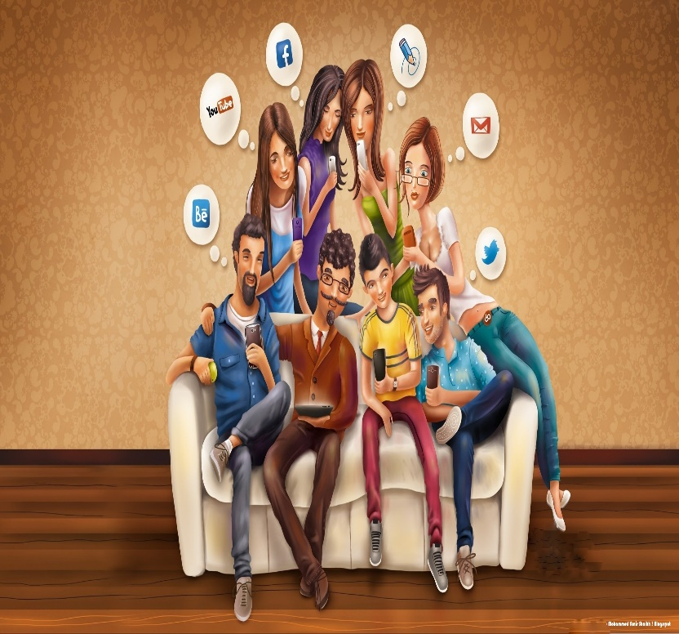
Social and Behavioral Impact
Show :
Decreased face-to-face interaction
Tech overuse in children and teens
Distraction in learning environment

Slide 7

Balancing Technology Use
Tips for healthy tech habits :
Set screen time limits
Practice digital detox
Use blue light filters
Take regular breaks (20-20-20 rule )

Slide 8
The Role of Innovation in Better Health
Mention :
AI in diagnostic and personalized treatment
Fitness trackers and behavior change
Robotic in surgery

Slide 9
Conclusion
Summarize :
Technology has both benefit drawbacks.
Responsible use is key to leveraging the good while minimizing harm.

Slide 10
THANK YOU
“KEEP IT SIMPLE AND FRIENDLY.”

